Slide 1
Unit 6
Lecture 2

Slide 2
Petrol electric traction
Petrol engine is used to drive the generator at constant speed.
Petrol-electric transmission was used for a variety of applications in road,rail, and marine transport, in the early 20th century.
After World War I, it was largely superseded by diesel-electric transmission, a similar transmission system used for diesel engines; but petrol-electric has become popular again in the 21st century in hybrid electric vehicles.

Slide 3
Battery electric drive
The locomotive carries the secondary batteries which supplies the power to dc motors employed for driving the vehicle.
Well suited for frequently operated service such as for local delivery of goods in large towns with maximum daily run of 50 to 60 km, shunting and traction in industrial works and mines.

Slide 4
Merits and demerits of battery electric drive
Merits
Demerits
Easy to control and very convenient to use.
Low maintenance cost
Absence of fumes
Major limitation is the small capacity of the batteries
necessity for frequent charging
Speed range is limited.

Slide 5
Electric drive
Most widely used
The vehicle draws electrical energy from the distribution system(from a contact wire suspended above the track or from an additional rail laid along side of it) fed at a suitable points from a central power stations or substations.

Slide 6
Advantages of electric drive
Cleanest of all other types of system of traction
No water and coaling depots are required
Electrical energy required for the lights and fans of the train can be drawn from the lines directly.
Owing to better speed control in electric drive locomotion in steep gradients at slow speed is possible
Rapid acceleration and braking retardation
Larger passenger carrying capacity.
Less time for maintenance and repairs than a steam locomotive
Maintenance and repair cost is about 50% of that of steam locomotive
Can be put into service immediately.
Absence of fumes
Vibrations are less as torque exerted is continuous.
Can withstand large temporary overloads and can draw relatively large power from the distributing system.
Saving of high grade coal and fuel.
Electric braking is superior to mechanical braking because of less wear on brake shoes, wheels and tracks. Also regenerative braking is possible.

Slide 7
Disadvantages of electric drive
Heavy initial expenditure for the power supply system
Because of Voltage drop substations have to be built at 40 to 50 km range
Failure of power supply may paralyse the whole system
Tied up to only electrified routes( not a self contained unit)
In case of ac traction the communication lines running along the track experience considerable interference from the power lines.

Slide 8
Systems of electric traction
Two systems:
Electric vehicle fed from distribution network
a. Systems operating with dc such as trolley bus, tramways and railways.
b. Systems operating with ac such as railways
Self contained locomotives
a. Diesel electric trains
b. Petrol electric trucks and lorries
c.Battery driven road vehicles

Slide 9
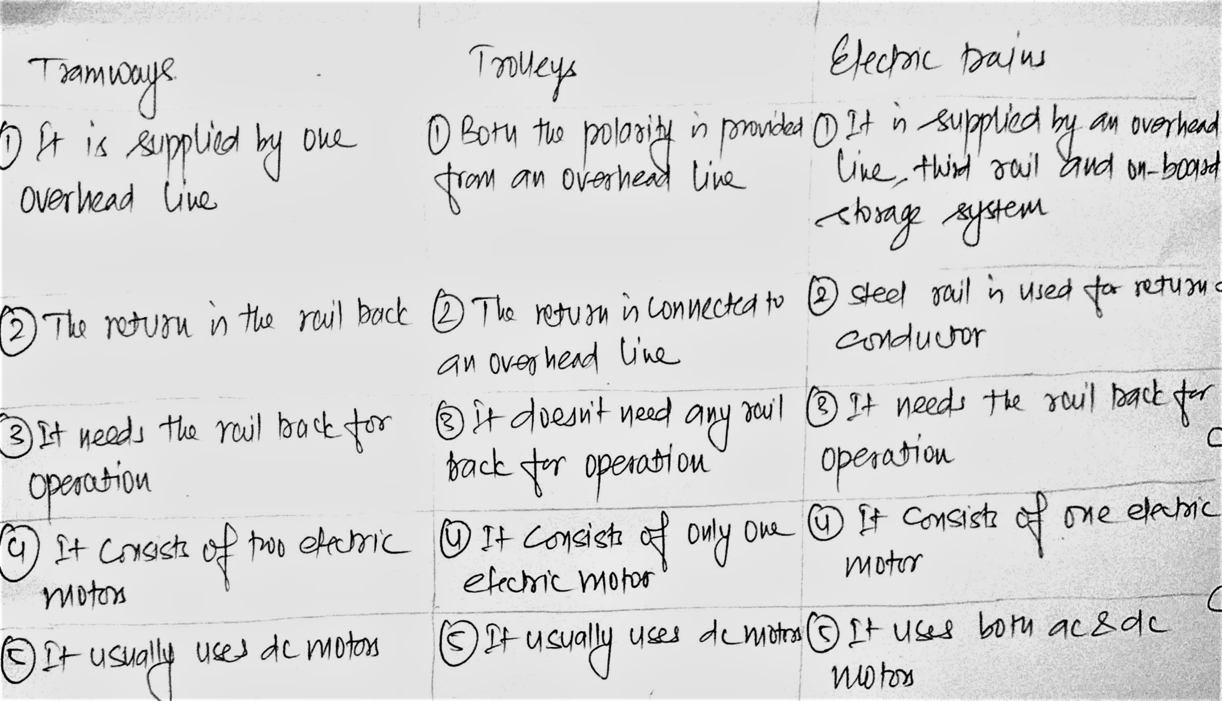
Comparison of tramways, trolleys and electric tains

Slide 10
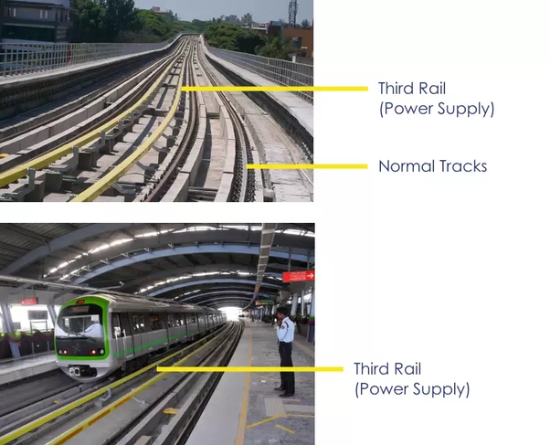

Slide 11
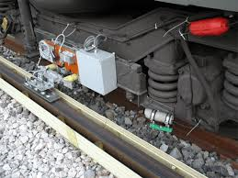
Third rail

Slide 12
Third rail and on board storage system
Third rail is the extra track laid aside the running track which is usually used for the return conductor.
On board electricity storage system is the storage system in which the energy during the braking period is stored in the battery which is used during the accelerating period so that power drawn from the supply remains constant.

Slide 13
Train movement and energy consumption
The movement of trains and their energy consumption can be most conveniently studied by means of speed-time and speed-distance curves, which show respectively the speed at different time instants after the start of run and the speed at different distances from the starting point.
Of the two, the speed-time curve is generally the more useful.

Slide 14
Speed-time curve
The curve drawn between speed and time, taking speed (in km/hour) on the Y-axis and time (in seconds or minutes) on X-axis, is known as speed-time curve.
The speed-time curve provides complete information of the motion of the train.
This curve gives the speed at various time instants after the start of run directly.
Slope of the curve at any point gives the acceleration at the corresponding instant or speed.
The area covered by the curve, the time axis and the ordinates through the instants between which the time is taken, represents the distance covered in the corresponding time.

Slide 15
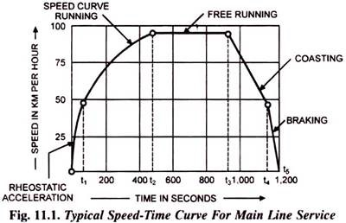
Speed-time curve(contd)
Speed-time curve
(Fig.11.1) mainly consists
of:
Initial acceleration
Constant speed run or free run
Coasting and
Retardation.

Slide 16
Acceleration
It consists of two parts known as:
Constant acceleration or acceleration while notching up and
Speed curve running or acceleration on the speed curve.

Slide 17
Constant Acceleration or Acceleration during Notching Up
During notching up period (0 to t₁) the current is maintained approximately constant and the voltage across the motor is gradually increased by cutting out the starting resistance.
Thus tractive effort is constant and, therefore, acceleration remains constant during this period.

Slide 18
Speed Curve Running or Acceleration on Speed Curve
During speed curve running (t₁ to t₂) the voltage acting across the motor remains constant and current starts decreasing with the increase in speed according to the characteristics of the motor and finally the current taken by the motor becomes constant.
During this period, though the train accelerates but acceleration decreases with the increase in speed and finally becomes zero at the speed at which the tractive effort developed by the motor becomes exactly equal to the resistance to motion of the train.

Slide 19
Free Run or Constant Speed Run
At the end of speed curve running i.e., at t₂ the train attains the maximum speed.
During this period the train runs with constant speed attained at and constant power is drawn.

Slide 20
Coasting
At the end of free running period (i.e., at t₃) power supply is cut off and the train is allowed to run under its own momentum.
The speed of train starts decreasing on account of resistance to the motion of train.
The rate of decrease of speed during coasting period is known as coasting retardation.

Slide 21
Retardation or Braking Period
At the end of coasting period (i.e., at t₄) the brakes are applied to bring the train to rest.
During this period speed decreases rapidly and finally reduces to zero.

Slide 22
Different types of services depending upon speed time curves
Urban or city service
Suburban service
Main line service

Slide 23
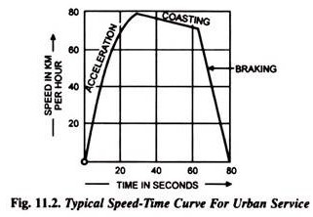
Urban or City Service
In urban or city service the distance between the two stops is comparatively very short (say 1 km or so).
The time required for this run is very small (few minutes).
The acceleration as well as retardation is required to be high so that high average speed and short time of run is obtained.
The acceleration and retardation for urban service is between 1.5 and 4 kmphps and between 3 and 4 kmphps respectively.
Free run is not present in this run.
The coasting retardation is about 0.15 kmphps. The coasting period is also small.
Typical speed time curve for urban service is shown in Fig. 11.2.

Slide 24
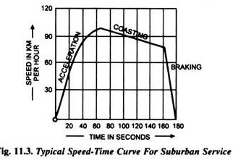
Suburban Service
In this service the distance between the stops is little longer than urban service but smaller than main line service (say between 2 and 5 km).
Free run is still not possible.
Coasting is for a comparatively longer period.
Acceleration and retardation required are as high as for urban service.

Slide 25
Main Line Service
The distance between two stops in main line service is considerably more (usually more than 10 km).
In this service free run is of longer duration.
The duration of acceleration and retardation is a small fraction of total running time.
Since rate of acceleration and retardation does not affect the average and schedule speeds, therefore, these are of little importance in main line service.

Slide 26
